Slide 1
Dawn Blossoms Plucked at Dusk
Block3 - image density estimation
Junru Jin
2023.5.24

Slide 2
Outline
1. HPO
2. Explore meaning of latent space dimensions for at least three different MNIST digits
3. Create a plot of the training curves

Slide 3
HPO
Because you should know which parameter is the best, I choose the FID as evaluation for generate imgs
Fréchet inception distance (FID):
1. to assess the quality of images created by a generative model, like a generative adversarial network (GAN).
2. Unlike the earlier inception score (IS), which evaluates only the distribution of generated images, the FID compares the distribution of generated images with the distribution of a set of real images ("ground truth").
Here, we use Inception v3 model as default to get embedding from generated images and real images

Slide 4
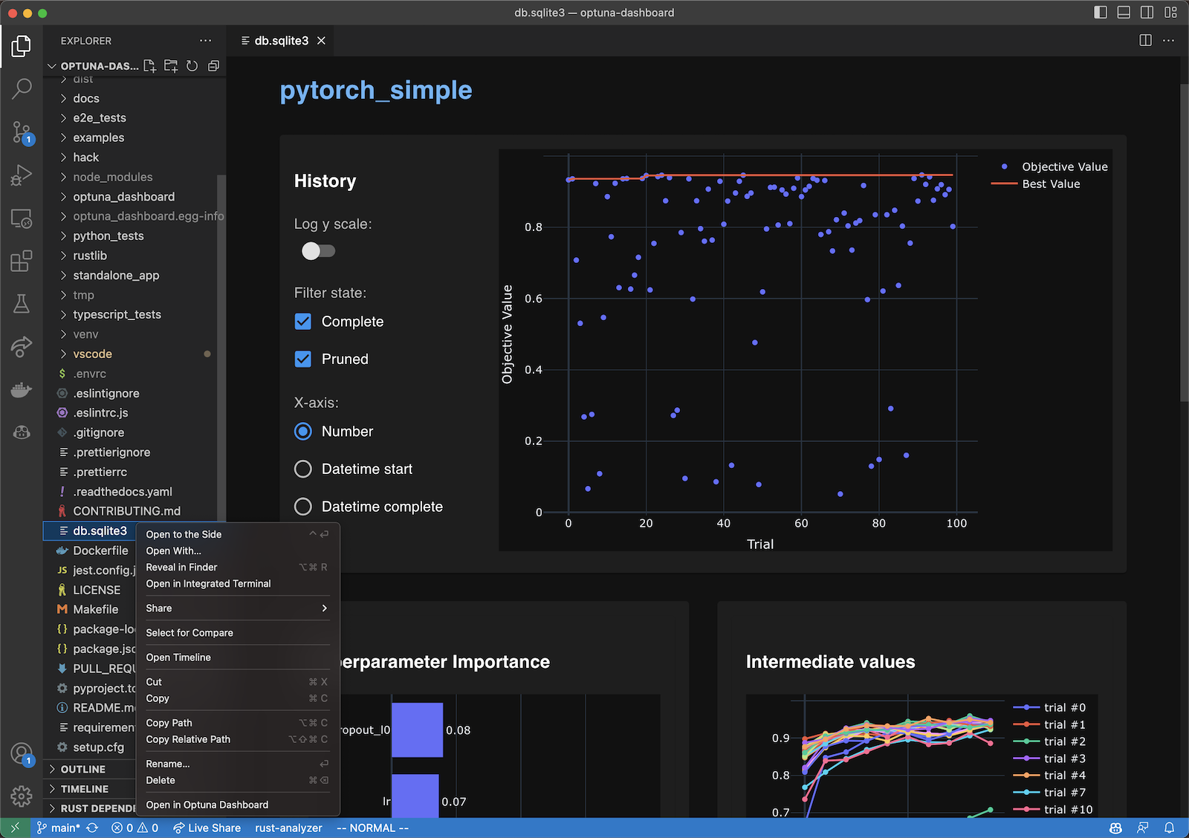
HPO
There are many tools to do HPO, here we choose optuna as it easily shown in VScode

Slide 5
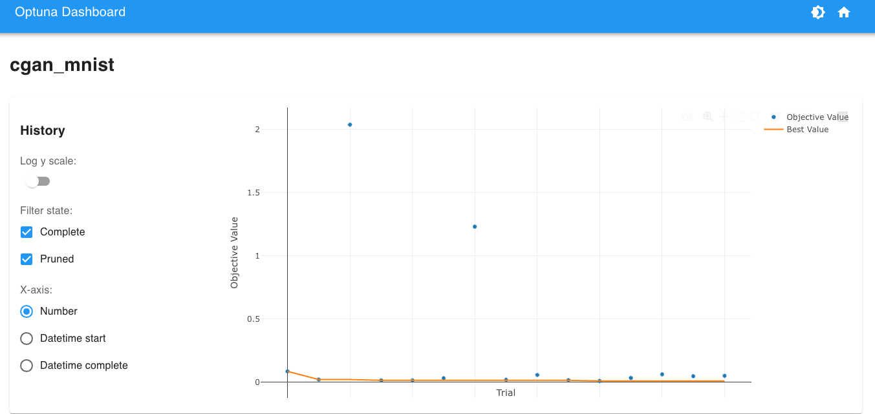
HPO
I choose learning rate and lantent space to do HPO

Slide 6
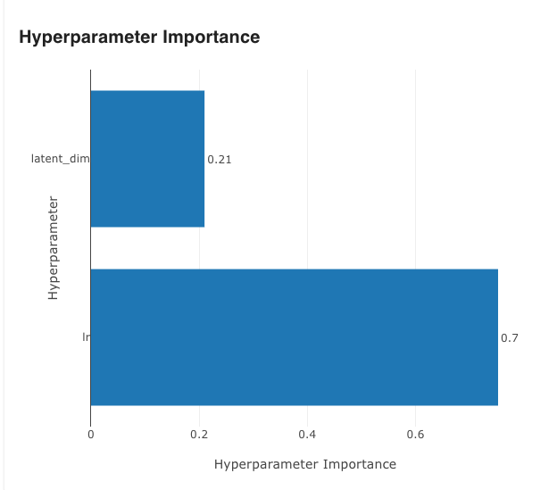
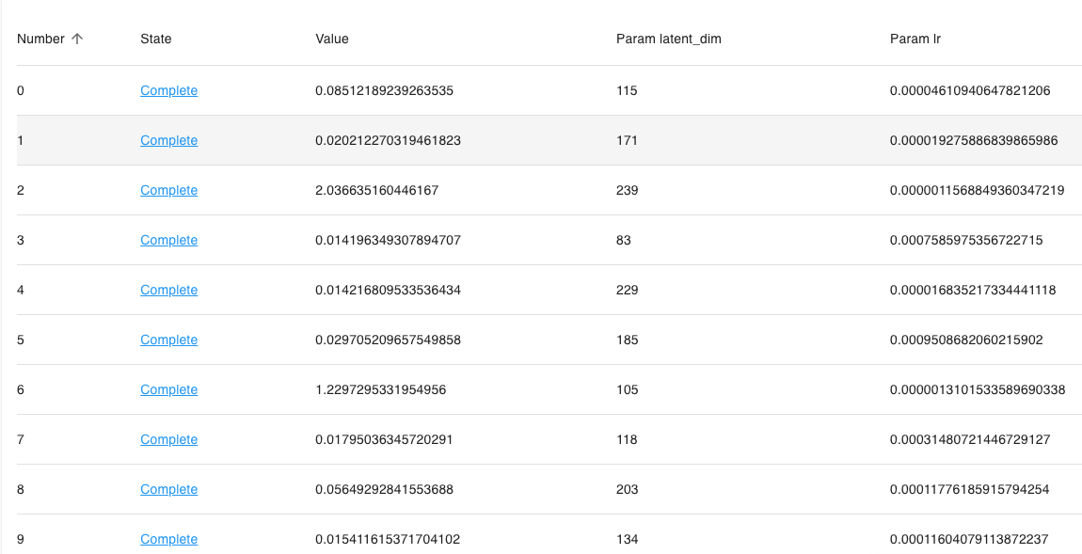
HPO
Learning rate is very important for the model training

Slide 7
HPO
Different learning rate and latent space will influcence cgan a lot

Slide 8
HPO
Different learning rate and latent space will influcence cgan a lot

Slide 9
Meaning of latent space dimensions
First, I use only two dim as latent space, but generate performance is too bad
Dim 2
Dim 2
Dim 1
Dim 1

Slide 10
Meaning of latent space dimensions
Then I use 8 dim as latent space dim
Dim 2
Dim 7
Dim 1
Dim 8

Slide 11
Meaning of latent space dimensions
Then I use 8 dim as latent space dim
Dim 2
Dim 7
Dim 1
Dim 8

Slide 12
Meaning of latent space dimensions
64 dim model
With improved dimensionality, the influence exerted by a single dimension will be reduced.
Dim 2
Dim 1

Slide 13
Meaning of latent space dimensions
I also use PCA and t-SNE to visualize lantent space

Slide 14
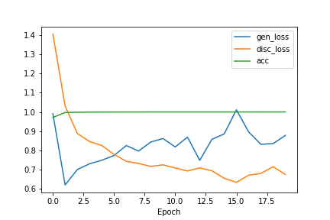
Training curves
I choose CVAE as model

Slide 15
Training curves
EPOCH 1

Slide 16
Training curves
EPOCH 2

Slide 17
Training curves
EPOCH 5

Slide 18
Training curves
EPOCH 15

